Slide 1

BI Business Intelligence

Slide 2
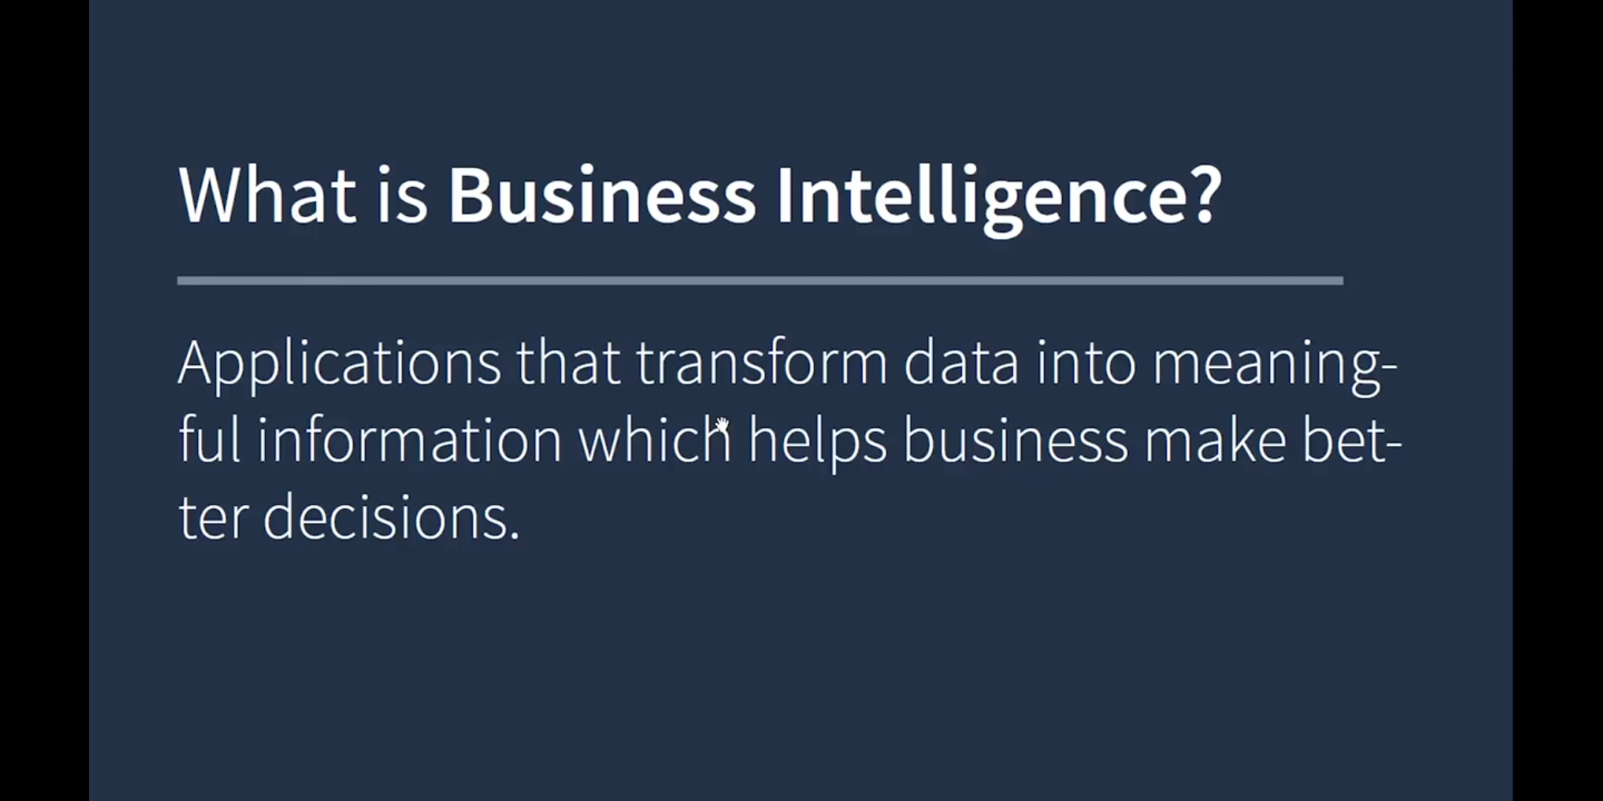

Slide 3
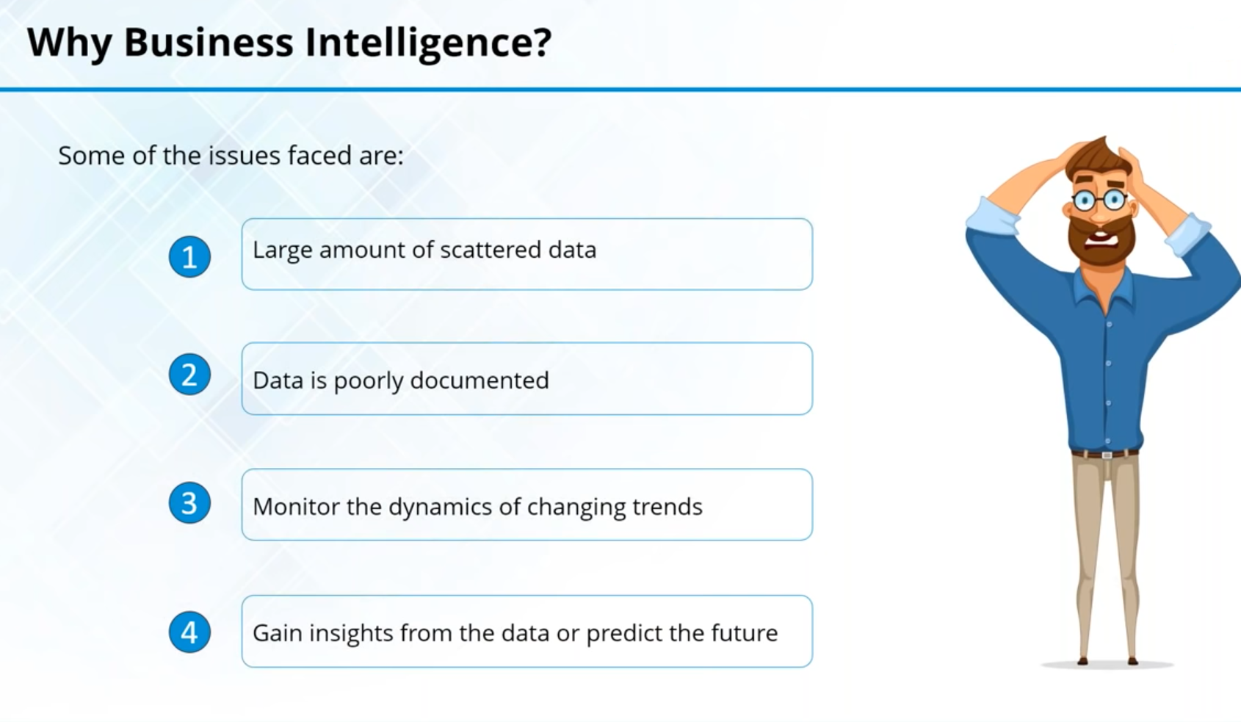

Slide 4
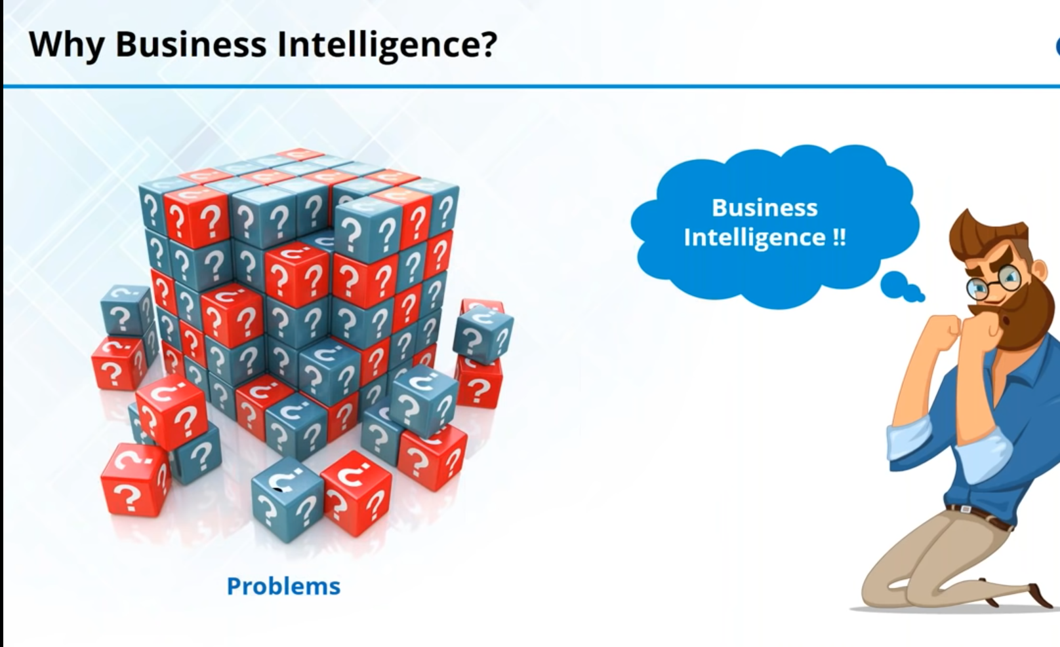

Slide 5
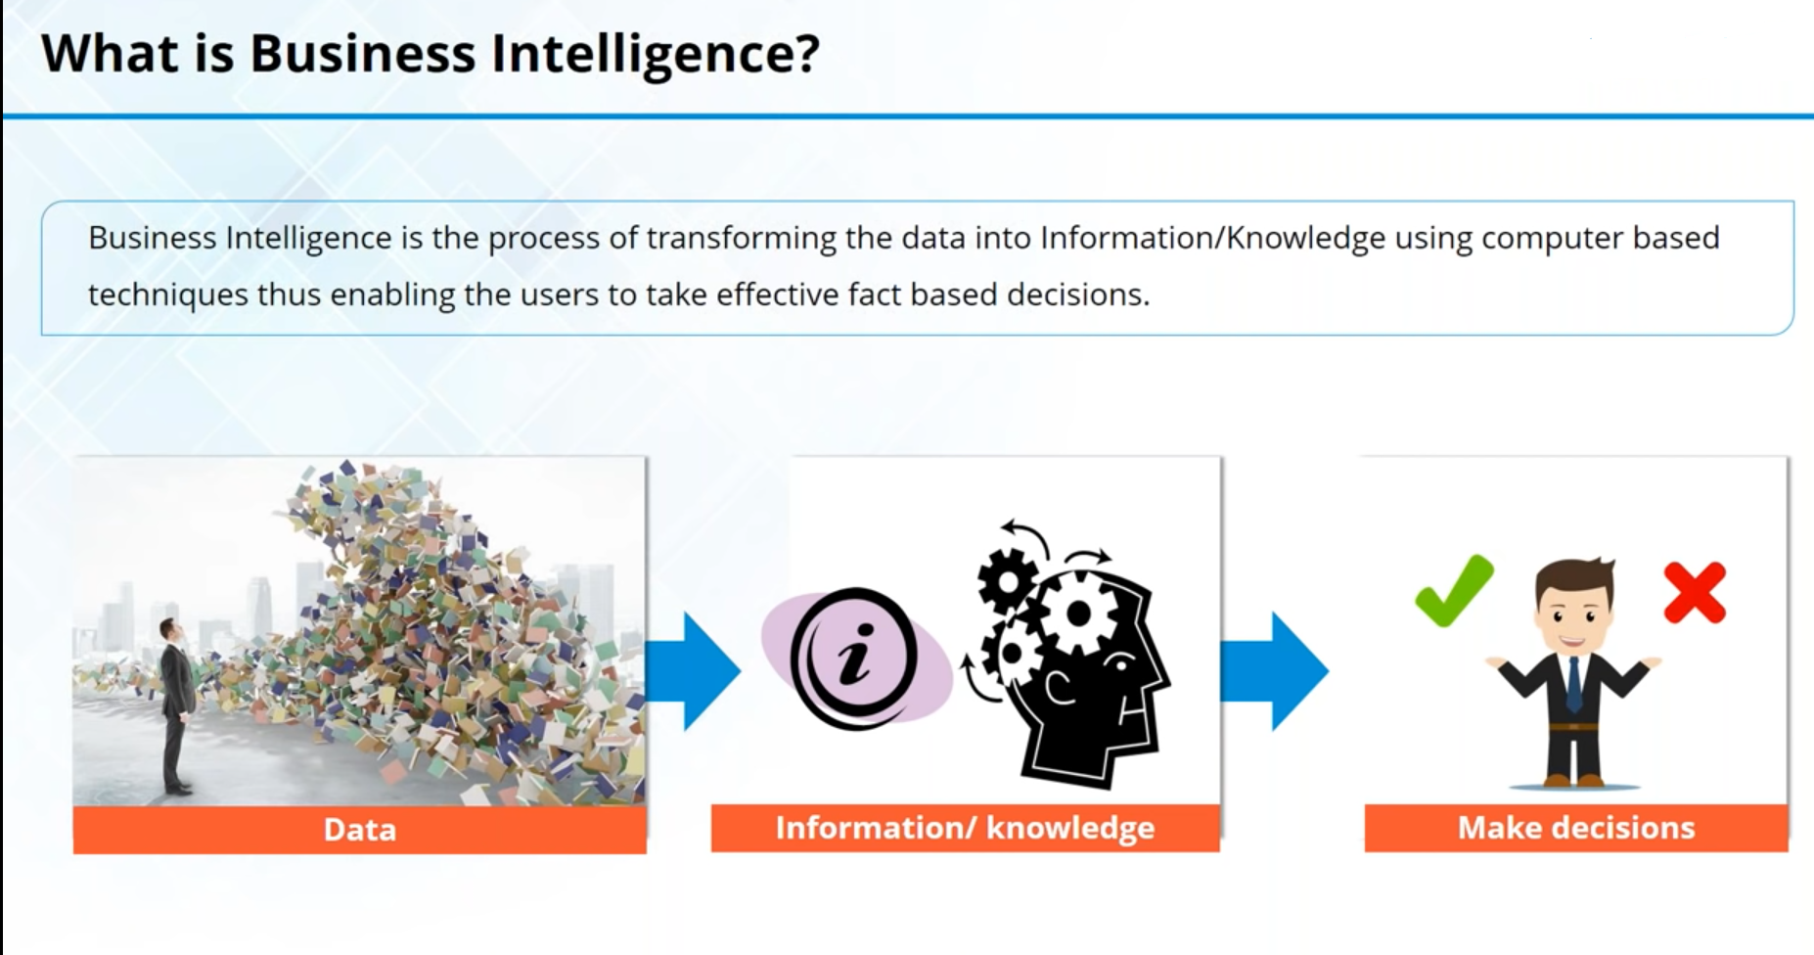

Slide 6
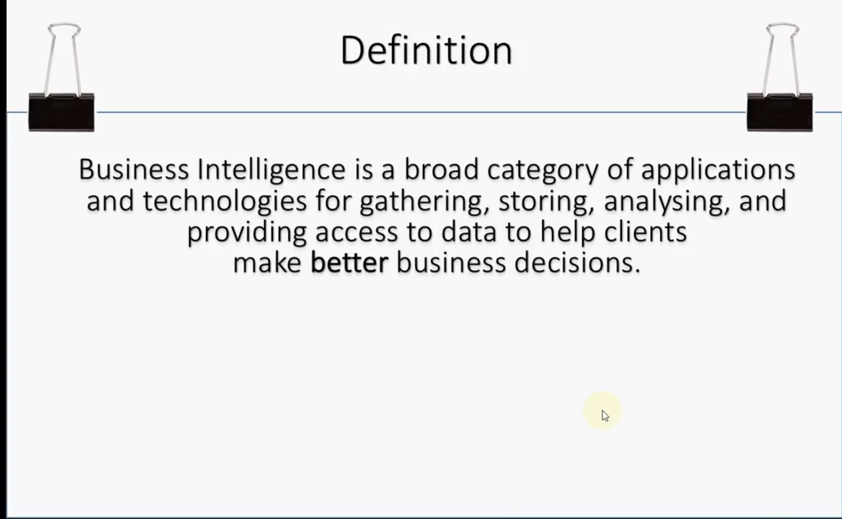

Slide 7
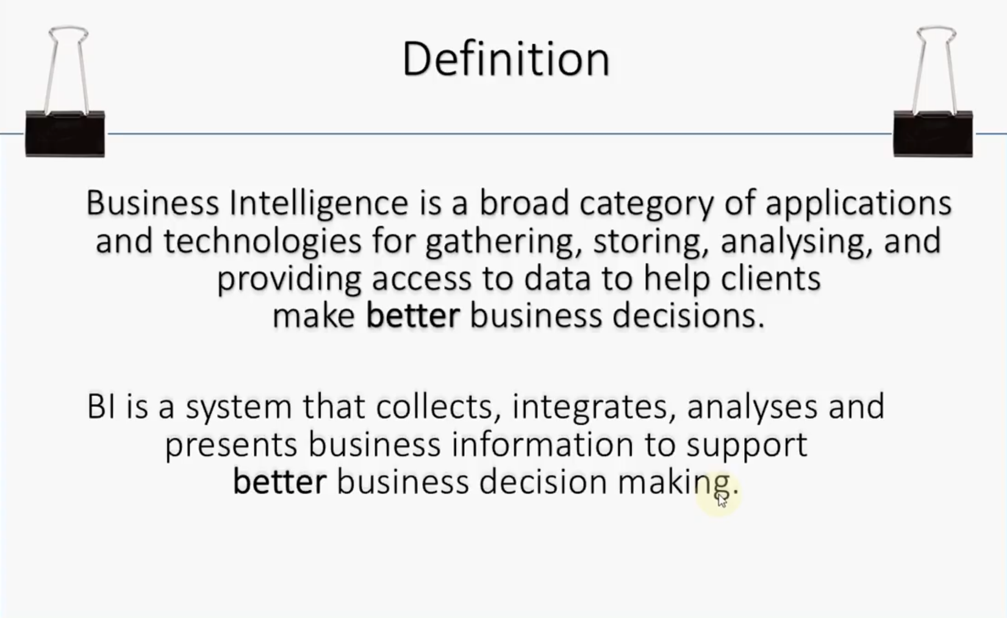

Slide 9
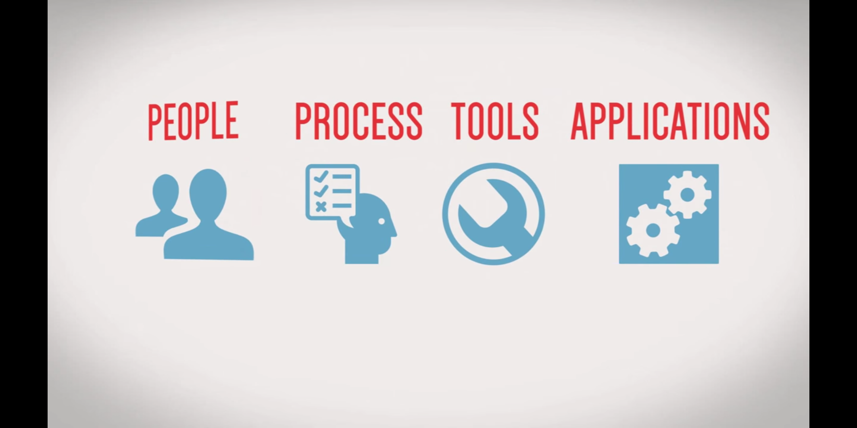
So BI INVOLVES ...

Slide 10
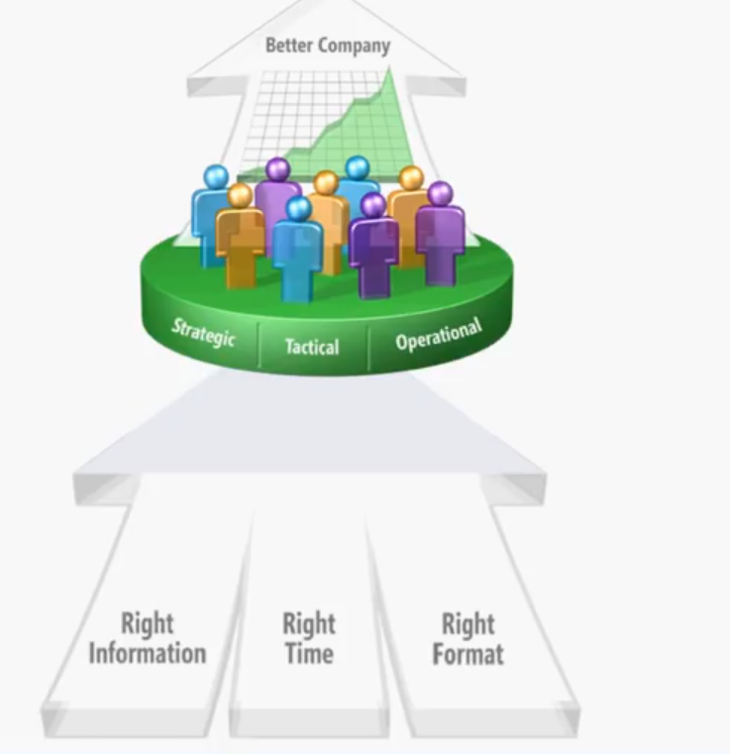

Slide 11
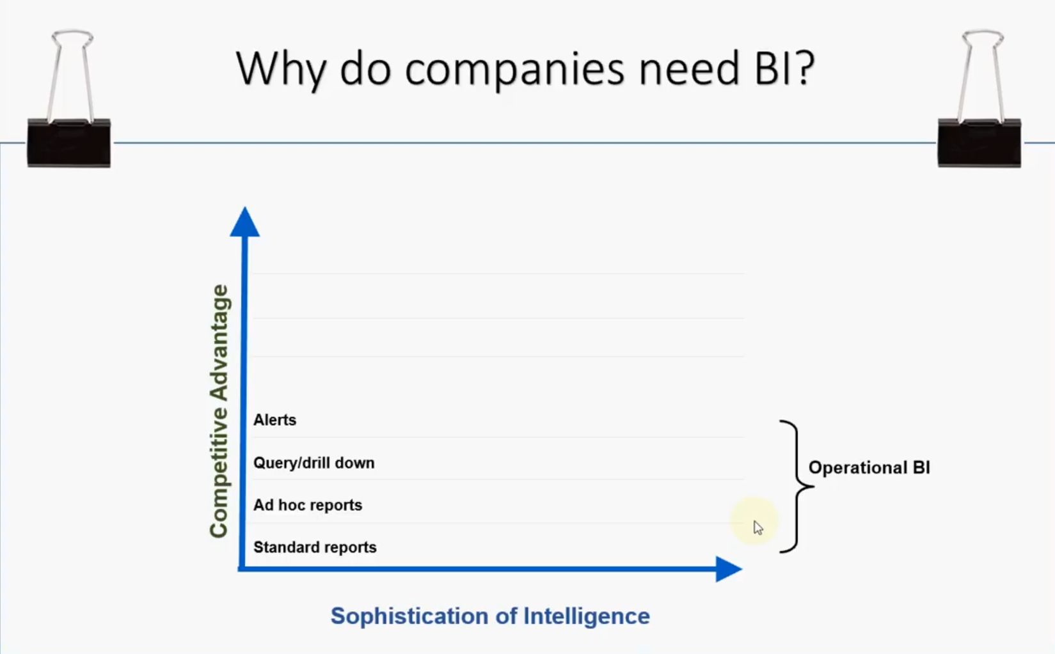

Slide 12
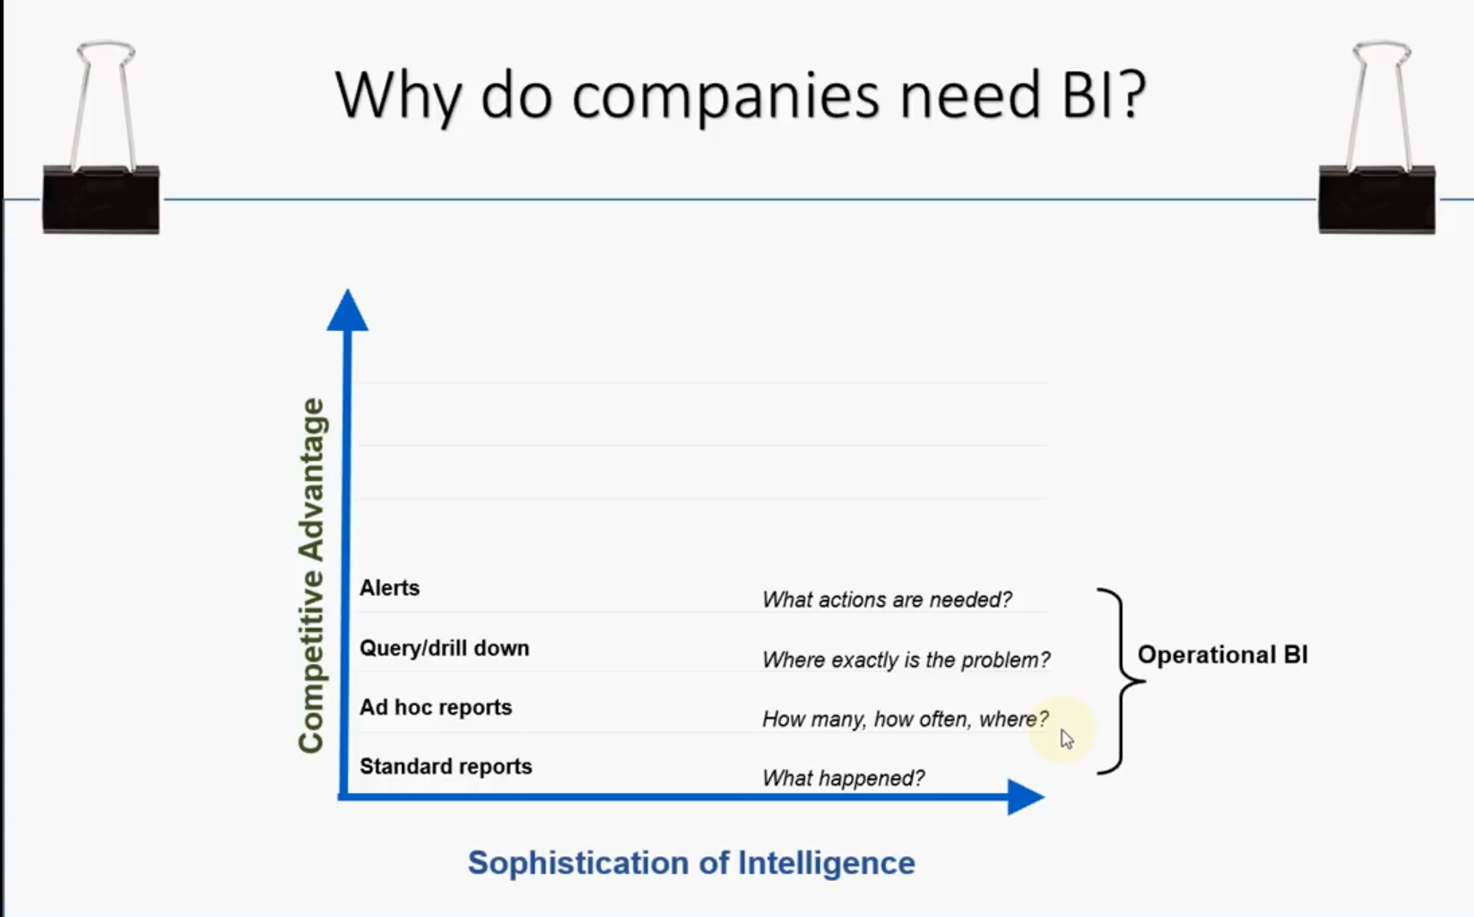

Slide 13
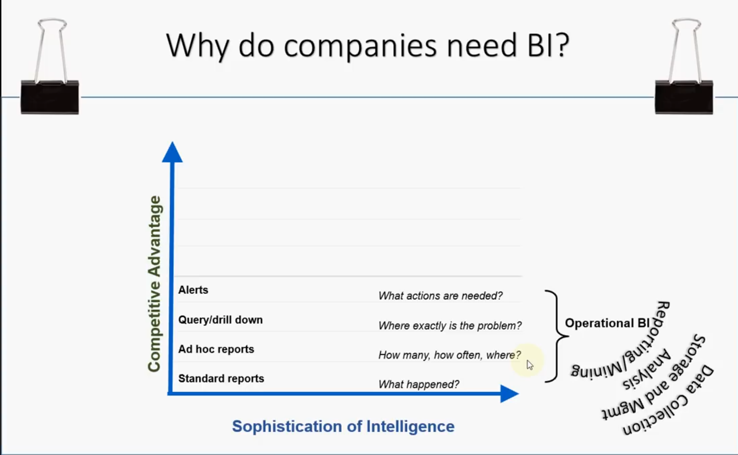

Slide 14
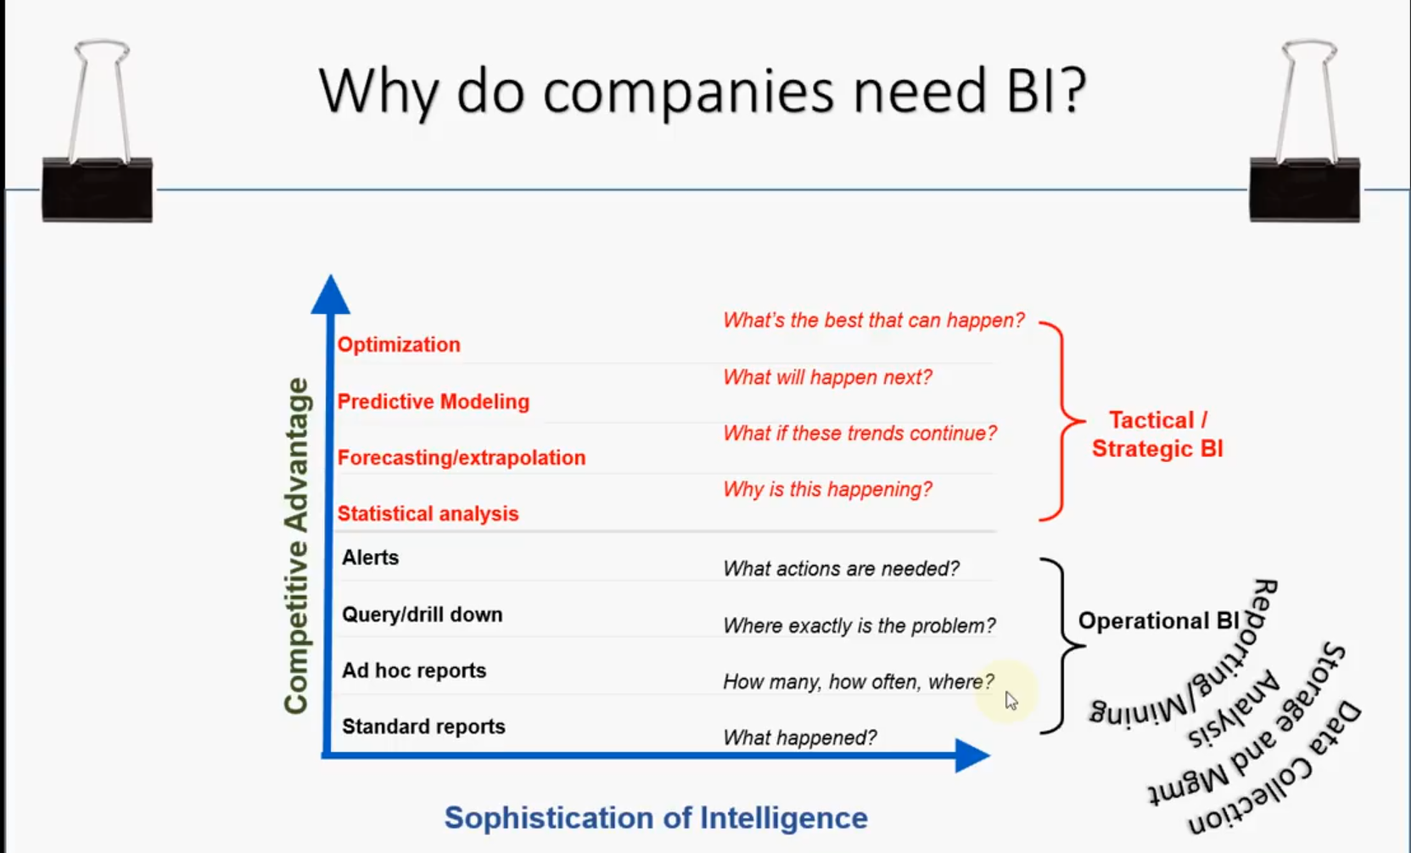

Slide 15
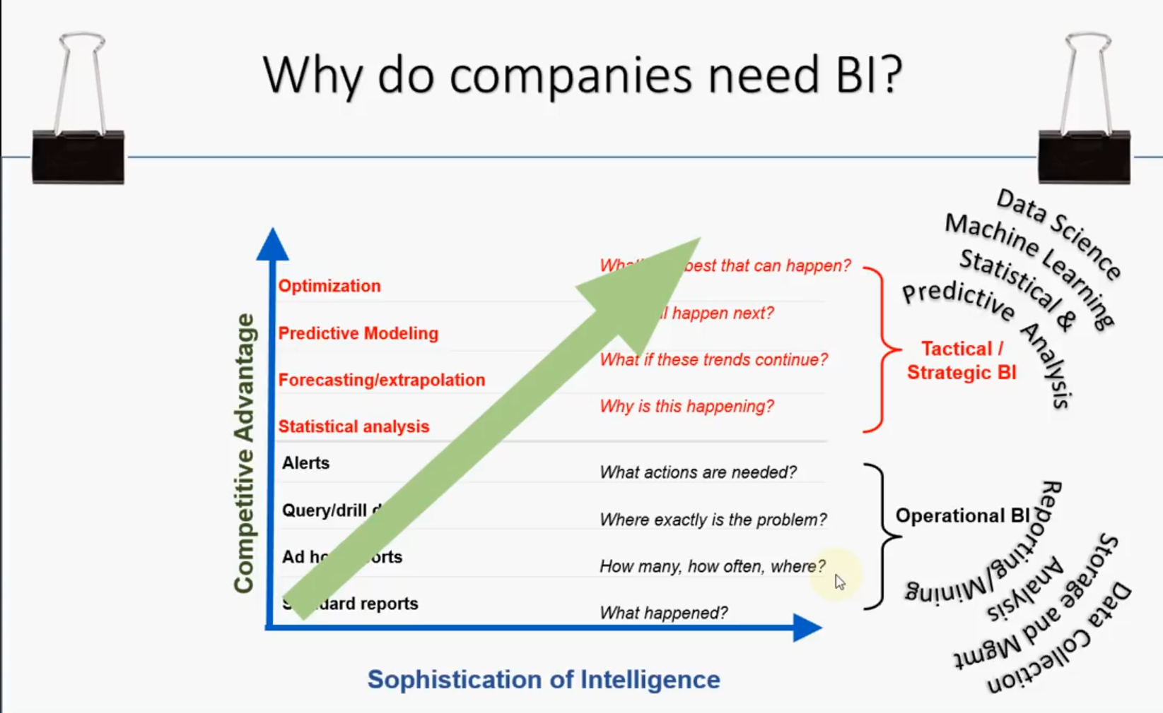

Slide 16
What is Business Intelligence?
BI(Business Intelligence) is a set of processes, architectures, and technologies that convert raw data into meaningful information that drives profitable business actions.It is a suite of software and services to transform data into actionable intelligence and knowledge.
BI has a direct impact on organization's strategic, tactical and operational business decisions. BI supports fact-based decision making using historical data rather than assumptions and gut feeling.
BI tools perform data analysis and create reports, summaries, dashboards, maps, graphs, and charts to provide users with detailed intelligence about the nature of the business.

Slide 17
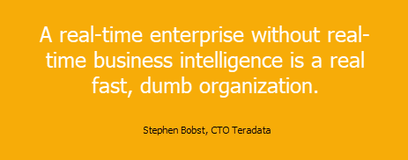
Why is BI important?
Measurement: creating KPI (Key Performance Indicators) based on historic data
Identify and set benchmarks for varied processes.
With BI systems organizations can identify market trends and spot business problems that need to be addressed.
BI helps on data visualization that enhances the data quality and thereby the quality of decision making.
BI systems can be used not just by enterprises but SME (Small and Medium Enterprises)

Slide 18
Architecture of Business Intelligence
Rome wasn’t built in a day, and neither is a business intelligence system of any organization. It requires lot of strategies and efforts to build such a solution.
To start with the effort of building business intelligence systems, one needs a framework comprising of best practices, policies, and standards. Business intelligence architecture, by providing this framework, ensures that the development efforts of multiple projects fit neatly together as a cohesive whole to achieve the desired BI system.
Let us briefly explore the architecture of a business intelligence system.

Slide 19
Why do we need Business Intelligence Architecture?
Much before an organization starts adopting a business intelligence architecture, there are series of indicators which accelerate the case for building a BI system. There are many important factors, but the key ones include:
Backlog of business requests: IT department is under a lot of pressure to fulfil the report requests from various business users.
Need for self-service BI: Business users are stuck as they need to depend on IT for even minor pieces of information. This hinders their decision-making process and forms a bottleneck for smooth operation.
Messed up IT system: Silos of data, different data formats, disparate data and applications – these will form a complex IT system, building a justified case for a stronger BI infrastructure.
Cost: Cost of maintaining information silos and feeding to huge number of IT resources for even small sets of data is detrimental to an organization
BI architecture, among other elements, often includes both structured and unstructured data. This data comes from both internal and external sources and are transformed from raw transaction data into logical information.

Slide 20
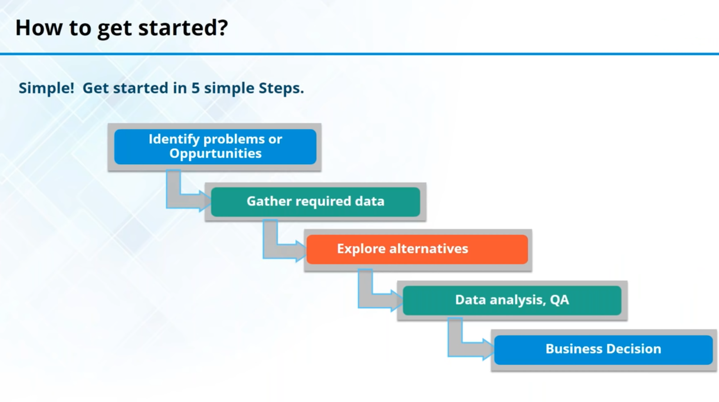

Slide 21
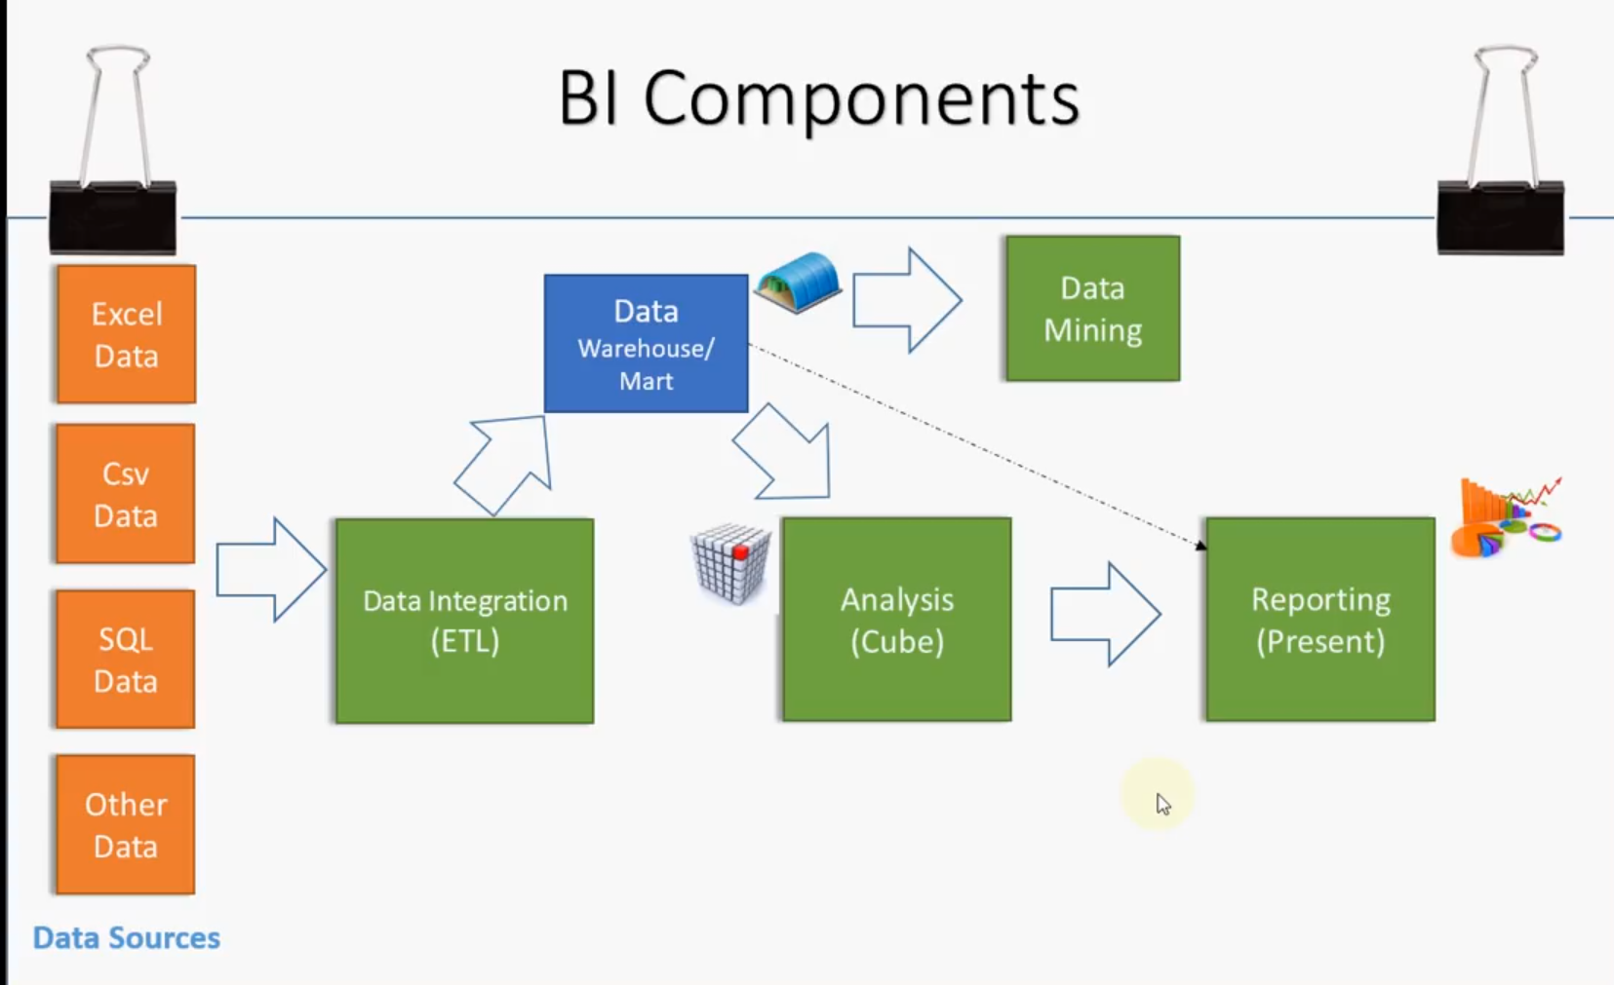

Slide 22
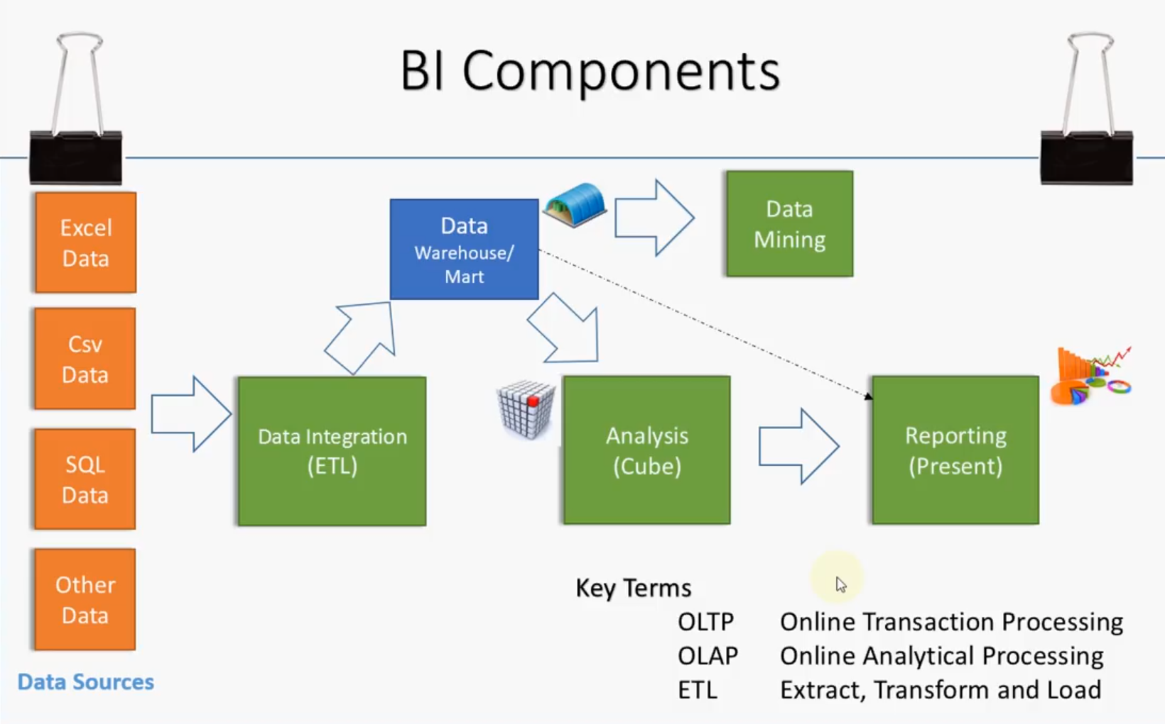

Slide 23
Components of Business Intelligence Architecture
The key elements of a business intelligence architecture are:
Source systems
ETL process
Data modelling
Data warehouse
Enterprise information management (EIM)
Appliance systems
Tools and technologies

Slide 24
1) Source Systems – Transaction Processing Systems
This is the starting point for any BI initiative. Organization data is first created in these databases. Point to note: if you do not capture the data in the operational system, you can’t analyze it.
Operational systems (OLTP) form the bulk of the data needed for the data warehousing. In addition to that, source systems may also include data from secondary sources such as market data, benchmarking data etc. Business Intelligence architecture should address all these various data sources which are of different formats and standards
2) ETL Process
In an ETL process data is extracted from the operational systems and loaded into a data warehouse. ETL, which stands for Extract Transform Load, is usually done using custom solutions available in the market. IBM Websphere Data Stage, Oracle Data Integrator, Ab Initio, and Microsoft Integration Services are examples of such tools.

Slide 25
3) Data Modeling
Data modeling will help to address what exactly is needed from data sources, the format of the data, and how it will be related to other data elements. It is not feasible to extract everything from a source system as that comes with cost issues. Data modeling will help to organize the data and therefore will minimize cost of storage replication, and effort needed to build a data warehouse.
4) Data Warehouse
Warehouse will have data extracted from various operational systems, transformed to make the data consistent, and loaded for analysis. A data warehouse will help in achieving cross-functional analysis, summarized data, and maintaining one version of the truth across the enterprise.

Slide 26
5) Enterprise Information Management (EIM)
EMI is another BI jargon which may stump some beginners. The term usually refers to ETL tools, data modeling tools, data quality, data profiling, metadata management, and master data management.
6) BI Hardware
It is important to make decisions on the hardware requirements to maintain a high performance and scalable BI system. Apart from server configurations, we have data warehouse appliances to combine the server, the database, and the data storage into one system. Netezza and DATAllegro are some well-known appliances in the market.
7) Tools and Technologies
Another important component of business intelligence architecture is what tools and technologies to implement. It is not just the front-end UI tools, but the tools used for EIM as well. There are cloud solutions, SaaS model, many full-fledged BI solutions (such as MSBI, Oracle BI suites, Microstrategy and more) to choose from. BI framework should have guidelines to make decisions on what is required for the organization.

Slide 27
How Business Intelligence systems are implemented?
Here are the steps:
Step 1) Raw Data from corporate databases is extracted. The data could be spread across multiple systems heterogeneous systems.
Step 2) The data is cleaned and transformed into the data warehouse. The table can be linked, and data cubes are formed.
Step 3) Using BI system the user can ask quires, request ad-hoc reports or conduct any other analysis.

Slide 28
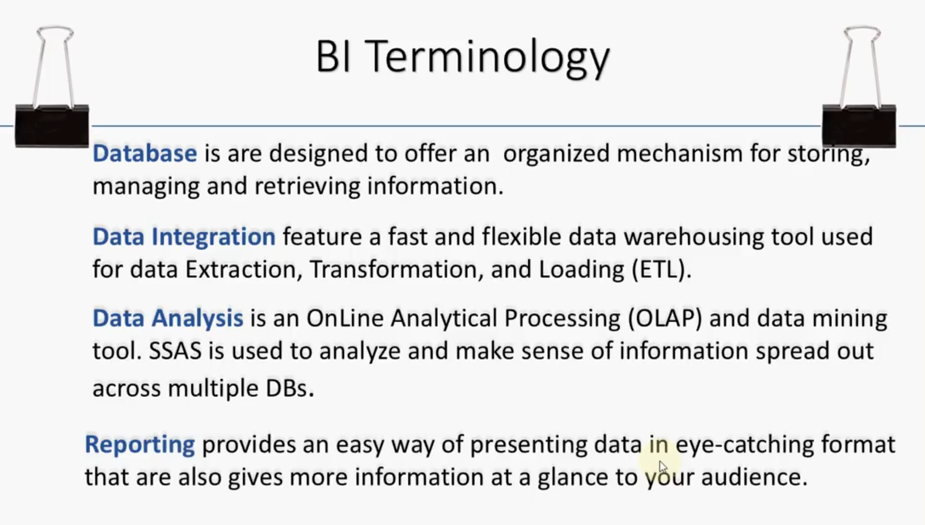

Slide 29
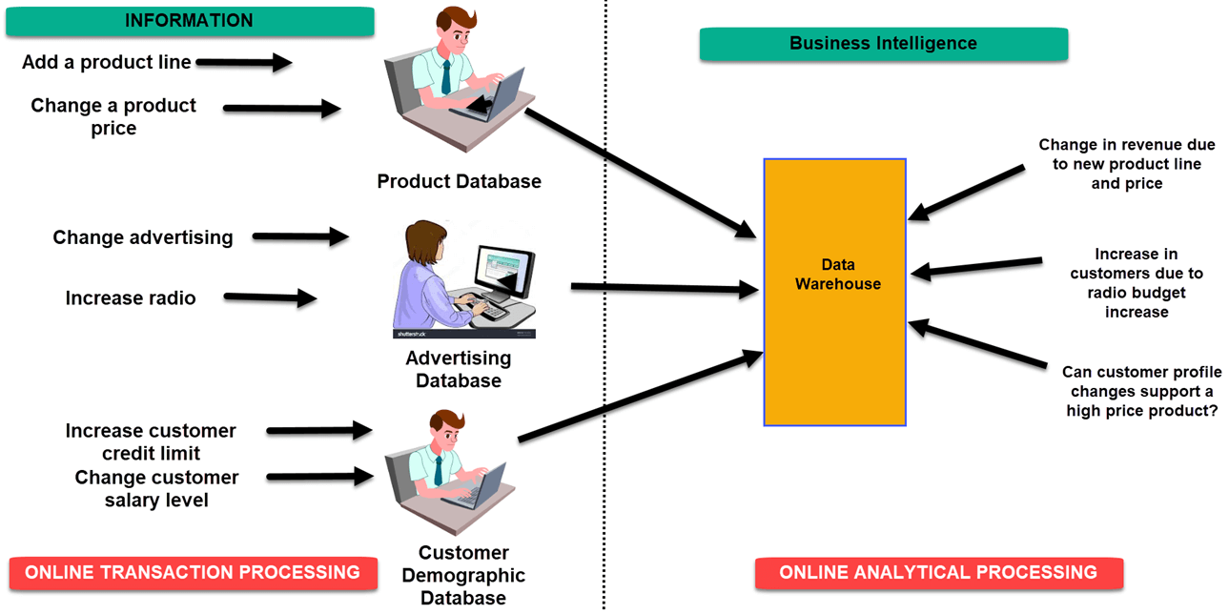
Examples of Business Intelligence System used in Practice

Slide 30
In an Online Transaction Processing (OLTP) system information that could be fed into product database could be
add a product line
change a product price
Correspondingly, in a Business Intelligence system query that would be executed for the product subject area could be did the addition of new product line or change in product price increase revenues
2. In an advertising database of OLTP system query that could be executed
Changed in advertisement options
Increase radio budget
Correspondingly, in BI system query that could be executed would be how many new clients added due to change in radio budget
3. In OLTP system dealing with customer demographic data bases data that could be fed would be
increase customer credit limit
change in customer salary level
Correspondingly in the OLAP system query that could be executed would be can customer profile changes support support higher product price

Slide 31
Example 2:
A hotel owner uses BI analytical applications to gather statistical information regarding average occupancy and room rate. It helps to find aggregate revenue generated per room.
It also collects statistics on market share and data from customer surveys from each hotel to decides its competitive position in various markets.
By analyzing these trends year by year, month by month and day by day helps management to offer discounts on room rentals.

Slide 32
Example 3:
A bank gives branch managers access to BI applications. It helps branch manager to determine who are the most profitable customers and which customers they should work on.
The use of BI tools frees information technology staff from the task of generating analytical reports for the departments. It also gives department personnel access to a richer data source.

Slide 33
Four types of BI users
Following given are the four key players who are used Business Intelligence System:
1. The Professional Data Analyst:
The data analyst is a statistician who always needs to drill deep down into data. BI system helps them to get fresh insights to develop unique business strategies.
2. The IT users:
The IT user also plays a dominant role in maintaining the BI infrastructure.
3. The head of the company:
CEO or CXO can increase the profit of their business by improving operational efficiency in their business.
4. The Business Users“
Business intelligence users can be found from across the organization. There are mainly two types of business users
1) Casual business intelligence user
2) The power user.
The difference between both of them is that a power user has the capability of working with complex data sets, while the casual user need will make him use dashboards to evaluate predefined sets of data.

Slide 34
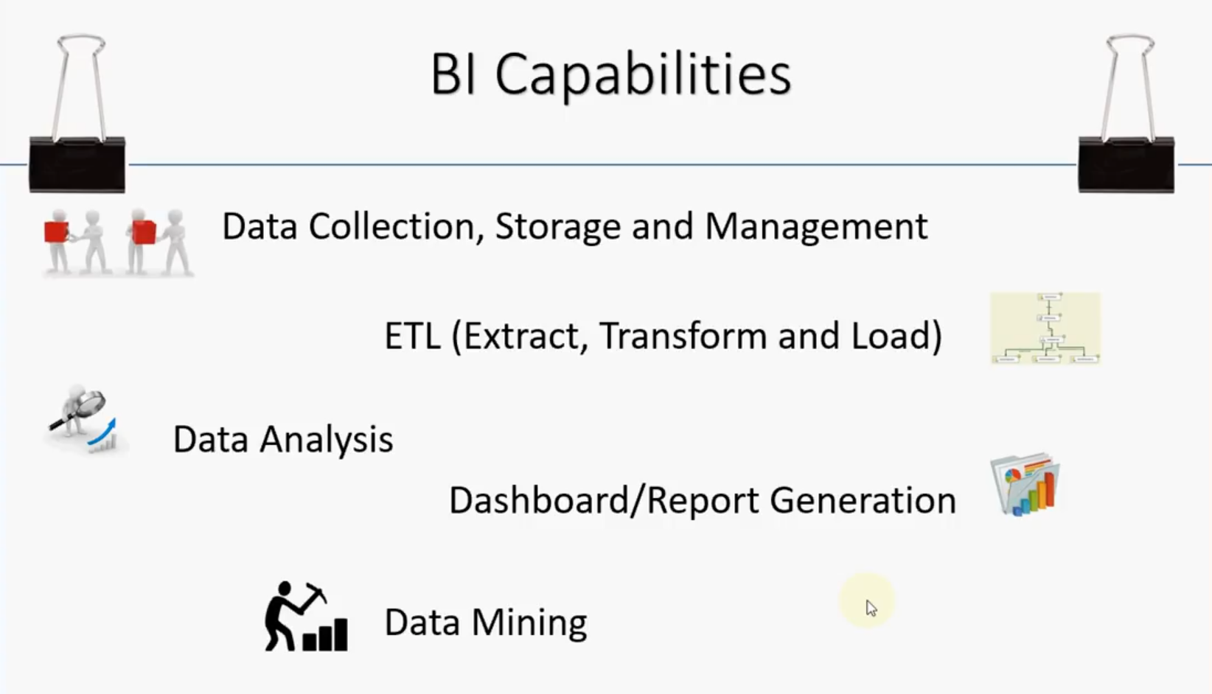

Slide 35
Advantages of Business Intelligence
1. Boost productivity
With a BI program, It is possible for businesses to create reports with a single click thus saves lots of time and resources. It also allows employees to be more productive on their tasks.
2. To improve visibility
BI also helps to improve the visibility of these processes and make it possible to identify any areas which need attention.
3. Fix Accountability
BI system assigns accountability in the organization as there must be someone who should own accountability and ownership for the organization's performance against its set goals.
4. It gives a bird's eye view:
BI system also helps organizations as decision makers get an overall bird's eye view through typical BI features like dashboards and scorecards.
5. It streamlines business processes:
BI takes out all complexity associated with business processes. It also automates analytics by offering predictive analysis, computer modeling, benchmarking and other methodologies.
6. It allows for easy analytics.
BI software has democratized its usage, allowing even nontechnical or non-analysts users to collect and process data quickly. This also allows putting the power of analytics from the hand's many people.

Slide 36
BI System Disadvantages
1. Cost:
Business intelligence can prove costly for small as well as for medium-sized enterprises. The use of such type of system may be expensive for routine business transactions.
2. Complexity:
Another drawback of BI is its complexity in implementation of data warehouse. It can be so complex that it can make business techniques rigid to deal with.
3. Limited use
Like all improved technologies, BI was first established keeping in consideration the buying competence of rich firms. Therefore, BI system is yet not affordable for many small and medium size companies.
4. Time Consuming Implementation
It takes almost one and half year for data warehousing system to be completely implemented. Therefore, it is a time-consuming process.

Slide 37
Trends in Business Intelligence
Artificial Intelligence: Gartner' report indicates that AI and machine learning now take on complex tasks done by human intelligence. This capability is being leveraged to come up with real-time data analysis and dashboard reporting.
Collaborative BI: BI software combined with collaboration tools, including social media, and other latest technologies enhance the working and sharing by teams for collaborative decision making.
Embedded BI: Embedded BI allows the integration of BI software or some of its features into another business application for enhancing and extending it's reporting functionality.
Cloud Analytics: BI applications will be soon offered in the cloud, and more businesses will be shifting to this technology. As per their predictions within a couple of years, the spending on cloud-based analytics will grow 4.5 times faster.

Slide 38
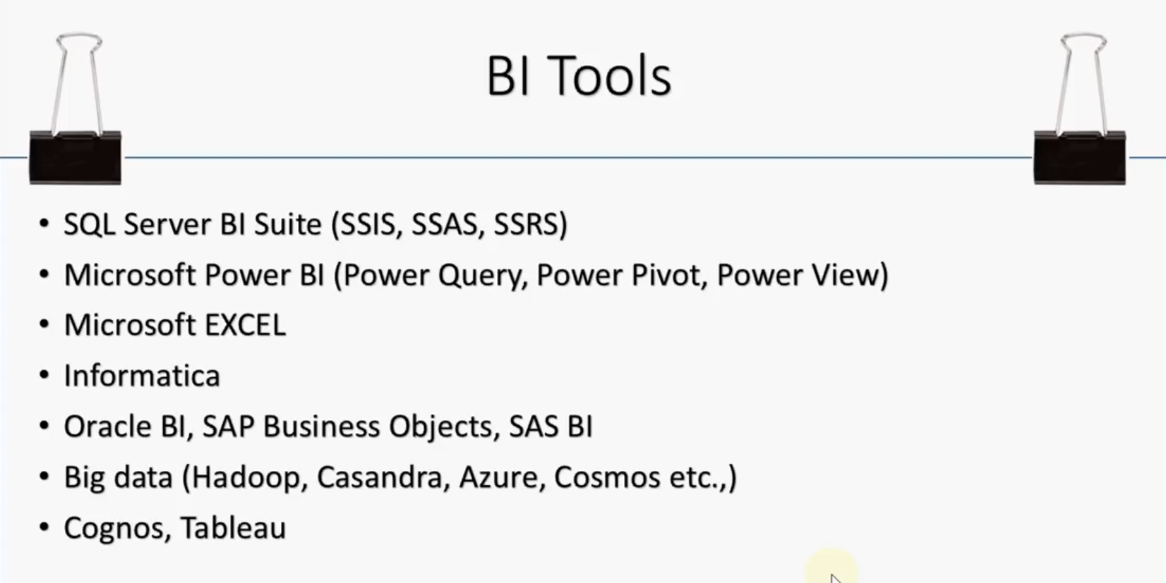

Slide 39
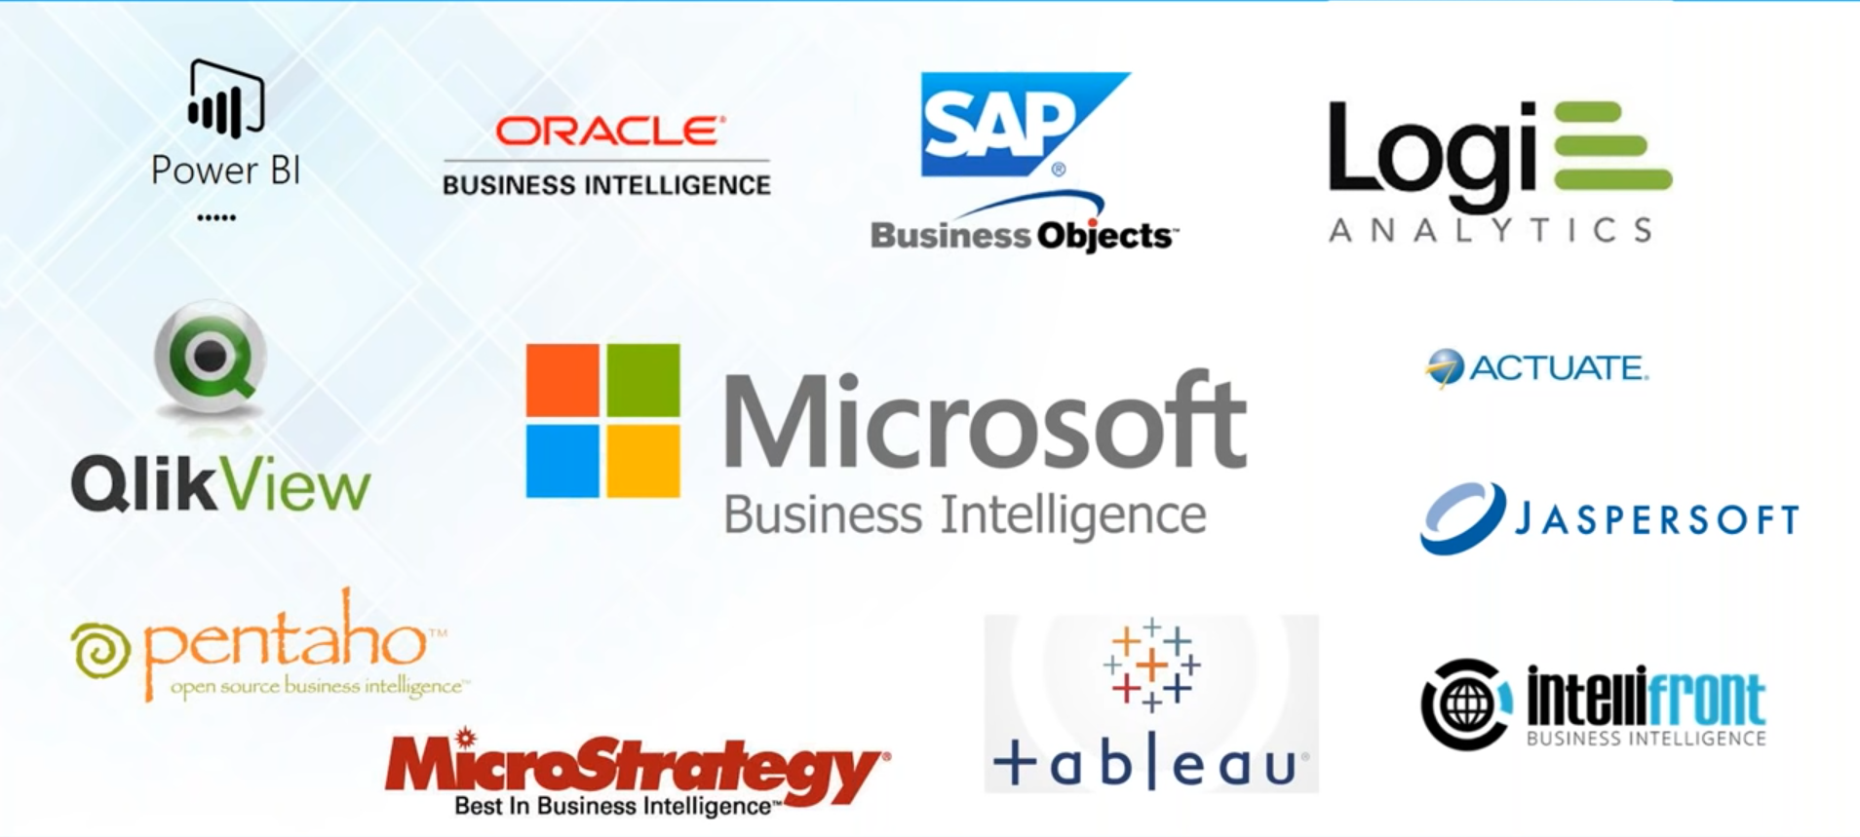

Slide 40
Summary
BI is a set of processes, architectures, and technologies that convert raw data into meaningful information that drives profitable business actions.
BI systems help businesses to identify market trends and spot business problems that need to be addressed.
BI technology can be used by Data analyst, IT people, business users and head of the company.
BI system helps organization to improve visibility, productivity and fix accountability. The draw-backs of BI is that it is time-consuming costly and very complex process.

